Slide 1

Crime control is an important responsibility/duty of any government, having an efficient system with the most important function being to suppress and control crime to ensure that society is safe and there is public order
Project by: MUWANI ROBSON

Slide 2

CONTENT
Background
Load Required Packages
Clean Up and Prepare Data for Analysis
Exploratory Data Analysis
Data Visualization
Summary of Findings

Slide 3
CONTEXT
Background
The purpose of this project is to perform data analysis and visualization for the Boston City crime data set. The analysis was carried out for Boston City using data recorded for a period of 4 years (2005-2018).
We used R to perform data analysis and visualization to explore and identify crime pattern, and uncover insights to understand how people commit different crimes

Slide 4
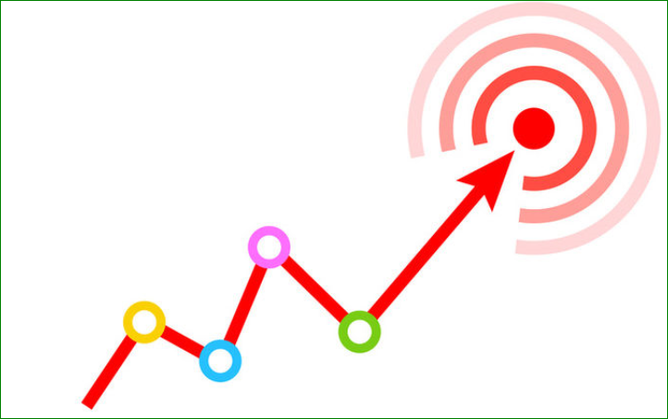
Objectives
Analyze crime pattern in Boston
Performing an analysis of Boston Crime data will be useful to law enforcement agents on how to deploy resources and to identify and apprehend suspects
Help US residence make well informed decisions when relocating to Boston city.
Provide useful information to international immigrants about the safety of Boston city

Slide 5

ANALYSIS QUESTIONS
What the crime distribution or pattern/trend from 2015-2018?
What are the most dangerous places in Boston?
What are the most dangerous streets in Boston?
What are the safe streets in Boston.?
What is the crime rate frequency per year?
What is the crime rate/ incidents per week of the day?
What is the crime rate frequency per season/month?
What is the crime incidence per time of the day?
What is the most reported incident/offense?
What is the most reported incident by area code?

Slide 6
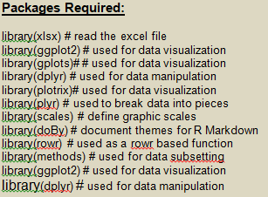

PACKAGES

Slide 7
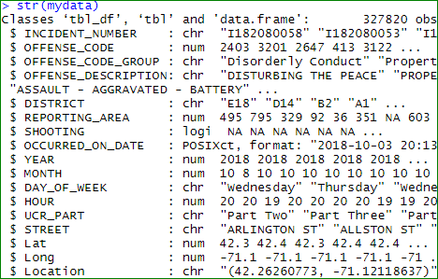
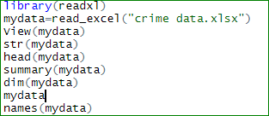
DATA PREPRATION
Read excel file code was used to read data from kaggle.com open data set (linked to the Government of Boston’s website) and save it as variable data crime.. The datasets is from August 2015 till today
December 21st 2018. This report is based on crimes reported to, and arrests made by, the Boston Police Department within the City of Boston.
Code

Slide 8
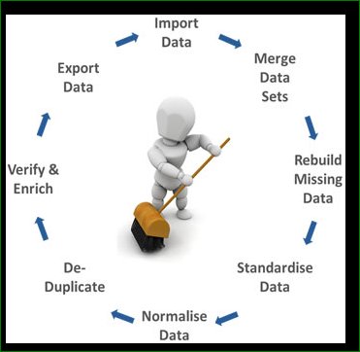
DATA CLEANING
Data has 327,820 observations and 17 columns.
No deletion was performed on missing data.
The variable(shooting) was ignored as the whole data set was missing

Slide 9
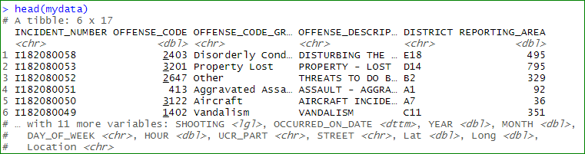

CRIME DATA(IMPORT)
Sample data (top 6 rows) after cleaning and importing.
Data set comprise of double and character strings

Slide 10
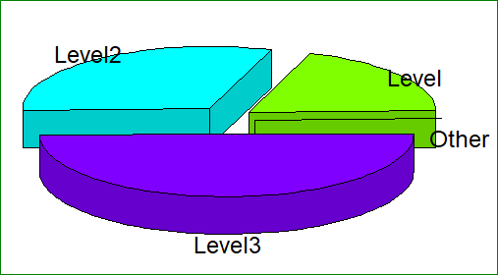
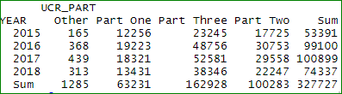
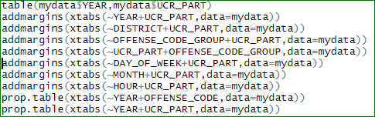
DATA ANALYSIS
Increase in crime from 2015
High crime rate in 2017
General decline in crime rate ( 2018)
Level 3 crime high through out the analysis period.
Code:

Slide 11
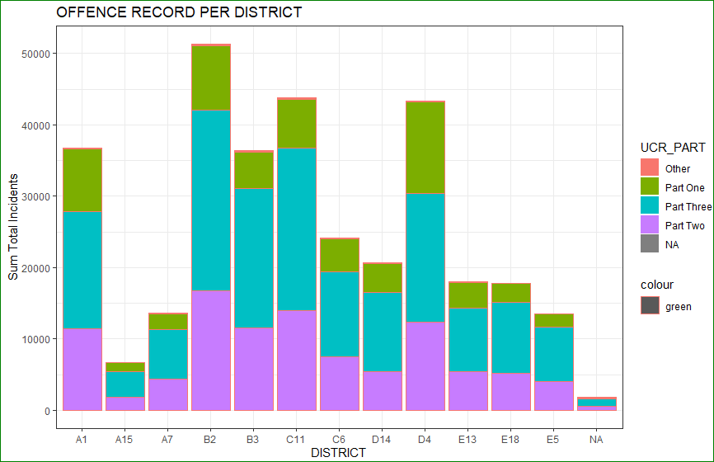

DATA ANALYSIS
District B2 recorded the highest crime rate, posting 51,272 counts.
D4 has the highest level one crime (12,775).
B2 and C11 Districts recorded the highest counts of level 2 and 3 crime for the entire period.
Code:

Slide 12
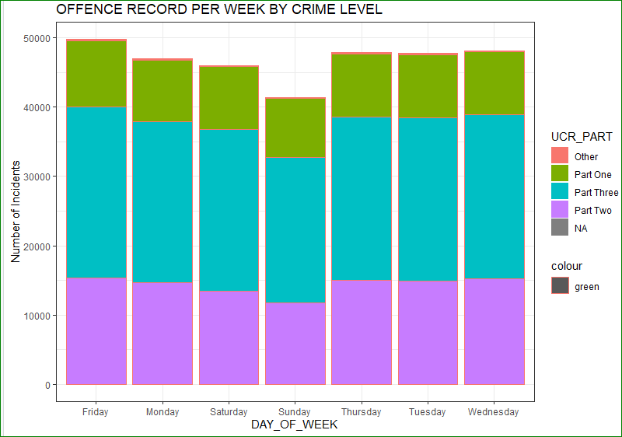
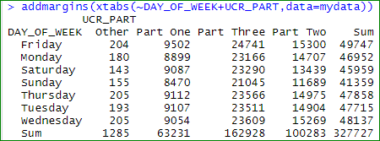
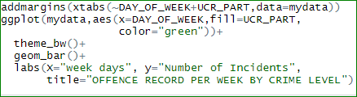
DATA ANALYSIS
More crime on Friday, Thursday and Tuesdays and Wednesdays are also bad days.
Sunday is relatively quiet in terms of crime
Code:

Slide 13
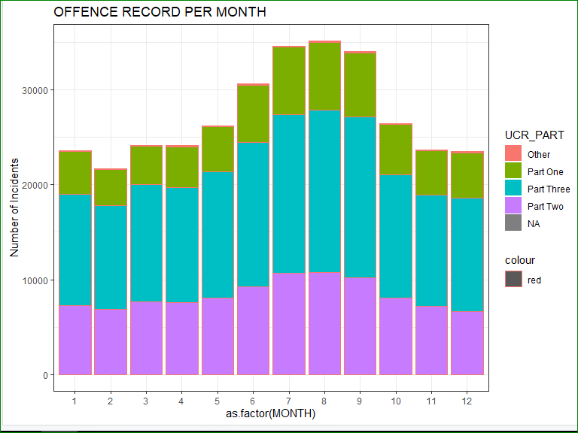

DATA ANALYSIS
More crime in summer, thus from June to September for all the levels
Level 3 crime remains high for all the seasons
Code:

Slide 14
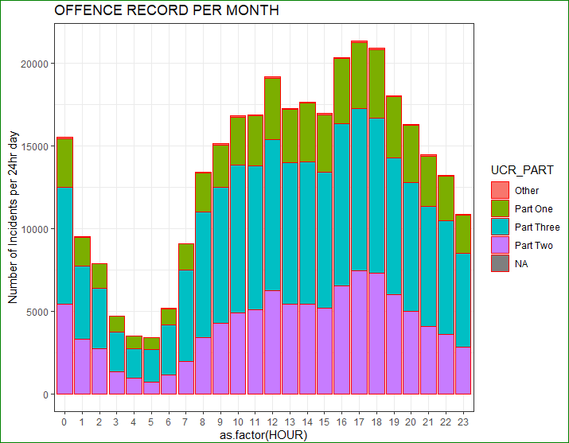

DATA ANALYSIS
Increase in crimes committed between 8am to midnight for all levels
Highest crime rate from 11am to 7pm for all the levels
Low level of crime from midnight to 6am
Code:

Slide 15
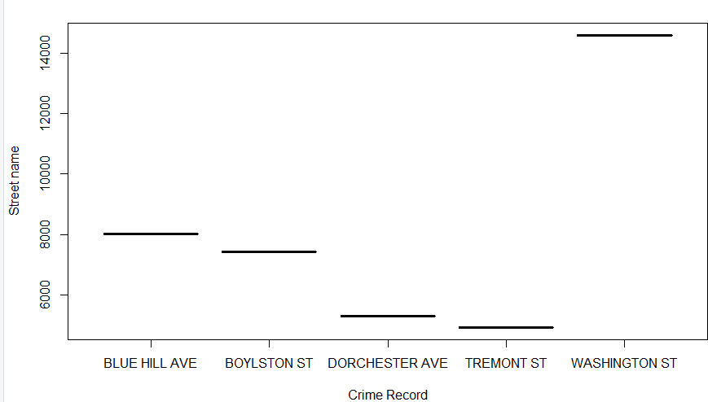

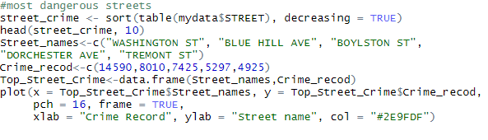
DATA ANALYSIS
The most dangerous street is Washington St (14,590 crimes reported)
Blue Hill Av was on second position recording (8,010 crime incidents)
The least on the top ten dangerous was Hyde Park recording(3572 incidents)
Code:

Slide 16


DATA ANALYSIS
The most safe streets are:
WINTHROP, WINTHROP LN, WINTHROP PD,WIRT ST, WITHROP SIDE AIRPOT, WOLCOTT,WOODBINE,WOODS MULLIN, WOODWARD PL , WORCESTER RD.
Each of these street recoded a single crime incident for the entire period.
Code

Slide 17
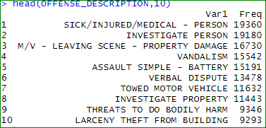
DATA VISUALISATION
SICK/INJURED/MEDICAL –recorded the highest (19360 counts), followed by a lot of cases under Investigation(19,180).
the least on the top ten extract was LARCENY THEFT FROM BUILDING (9293 cases)
Code

Slide 18
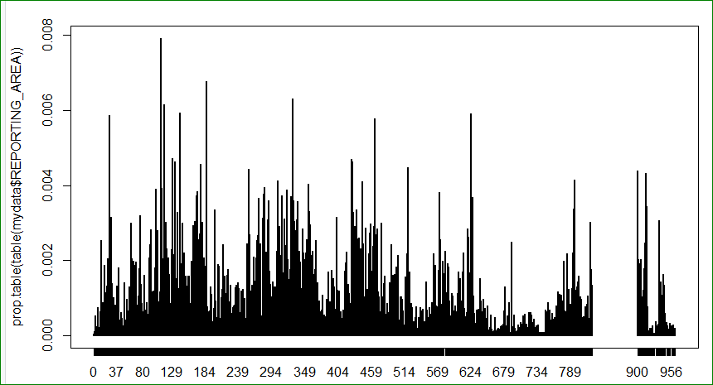
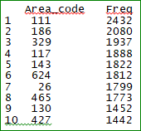
DATA VISUALISATION
Region with Area code (111) reported the highest incidents (2432) , followed by area code (186)
area code (427) was at the bottom of the list posting (1442 incidents)

Slide 19
SUMMARY FINDINGS
Conclusions:
As deduced from the analysis on the Boston Crime data set in terms of crime occurrence , distribution and time pattern below is the summary findings:
Most dangerous places/districts in Boston is B2,D4 C11,
Most dangerous streets in Boston is Washington St , Blue Av , Hyde Park, Massachusetts Av, Harrison Av etc
Highest number of crimes reported in Summer (June to Sep)
Days that crime is high Wednesdays and Fridays
Time of the day most likely to get more crime reports is from 11am to 7pm.

Slide 20
SUMMARY FINDINGS
Recommendations:
This Analysis helps the Boston Police act accordingly and try to reduce the crimes frequently occurring in the city of Boston by knowing the times, dates, places and seasons to increase field focus.
It also further helps them to know which district to add more reinforcement to try and curb crime. By looking at frequency of Incidents by District: B2, D4 and C11 have the highest cumulative incidents across the analysis period.
The analysis helps residence and new residence to know which area are safe, streets to avoid and at what time of the day. It further helps to choose areas to stay in Boston by avoiding the dangerous cities as depicted by the Analysis.

Slide 21
Appendix: R Programming Codes
getwd()
setwd("C:\\Users\\rmuwani\\Desktop\\Final_Project")
install.packages("readxl")
library(readxl)
mydata=read_excel("crime data.xlsx")
View(mydata)
str(mydata)
head(mydata)
summary(mydata)
dim(mydata)
mydata
names(mydata)

Slide 22
Appendix: R Programming Codes
table(mydata$UCR_PART)
# Pie Chart with Percentages
slices <- c(1285, 63231, 100283,162928)
lbls <- c("Other", "Level", "Level2", "Level3")
pct <- round(slices/sum(slices)*100)
lbls <- paste(lbls, pct) # add percents to labels
lbls <- paste(lbls,"%",sep="") # ad % to labels
pie(slices,labels = lbls, col=rainbow(length(lbls)),
main="Pie Chart of Crime Levels")
par(mar=c(1,1,1,1))
library(plotrix)
slices <- c(1285, 63231, 100283,162928)
lbls <- c("Other", "Level", "Level2", "Level3")
pie3D(slices,labels=lbls,explode=0.15,
main="Pie Chart of Countries ")

Slide 23
Appendix: R Programming Codes
table(mydata$YEAR,mydata$UCR_PART)
addmargins(xtabs(~YEAR+UCR_PART,data=mydata))
addmargins(xtabs(~DISTRICT+UCR_PART,data=mydata))
addmargins(xtabs(~OFFENSE_CODE_GROUP+UCR_PART,data=mydata))
addmargins(xtabs(~UCR_PART+OFFENSE_CODE_GROUP,data=mydata))
addmargins(xtabs(~DAY_OF_WEEK+UCR_PART,data=mydata))
addmargins(xtabs(~MONTH+UCR_PART,data=mydata))
addmargins(xtabs(~HOUR+UCR_PART,data=mydata))
prop.table(xtabs(~YEAR+OFFENSE_CODE,data=mydata))
prop.table(xtabs(~YEAR+UCR_PART,data=mydata))

Slide 24
Appendix: R Programming Codes
ggplot(mydata,aes(x=YEAR,fill=UCR_PART,color="green"))+
theme_bw()+
geom_bar()+
labs(X="Year of Incident", y="Number of Incidents",title="OFFENCE RECORD PER YEAR")
ggplot(mydata,aes(x=as.factor(MONTH),fill=UCR_PART,color="red"))+
theme_bw()+
geom_bar()+
labs(X="Year of Incident", y="Number of Incidents",title="OFFENCE RECORD PER MONTH")
ggplot(mydata,aes(x=as.factor(HOUR),fill=UCR_PART,color="red"))+
theme_bw()+
geom_bar(color="red")+
labs(X="Year of Incident", y="Number of Incidents",title="OFFENCE RECORD PER MONTH")

Slide 25
Appendix: R Programming Codes
levels("Monday","Tuesday","Wednesday","Thursday","Friday","Saturday")
ggplot(mydata,aes(x=as.factor(DAY_OF_WEEK),fill=UCR_PART,
color="green"))+
theme_bw()+
geom_bar()+
labs(X="Year of Incident", y="Number of Incidents",title="OFFENCE RECORD PER YEAR")
#most dangerous streets
street_crime <- sort(table(mydata$STREET), decreasing = TRUE)
head(street_crime, 10)
Street_names<-c("WASHINGTON ST", "BLUE HILL AVE", "BOYLSTON ST",
"DORCHESTER AVE", "TREMONT ST")
Crime_recod<-c(14590,8010,7425,5297,4925)
Top_Street_Crime<-data.frame(Street_names,Crime_recod)
plot(x = Top_Street_Crime$Street_names, y = Top_Street_Crime$Crime_recod,
pch = 16, frame = TRUE,
xlab = "Crime Record", ylab = "Street name", col = "#2E9FDF")
dev.off()
#least dangerous streets
(street_crime <- sort(table(mydata$STREET), decreasing = TRUE))
(tail(street_crime, 10))

Slide 26
Appendix: R Programming Codes
#crime by offense description, top 10
OFFENSE_DESCRIPTION <- data.frame(sort(table(mydata$OFFENSE_DESCRIPTION), decreasing = TRUE))
-head(OFFENSE_DESCRIPTION,10)
#crime by reporting area
plot(prop.table(table(mydata$REPORTING_AREA)))
REPORTING_AREA <- data.frame(sort(table(mydata$REPORTING_AREA), decreasing = TRUE))
head(REPORTING_AREA, 10)

